Slide 1
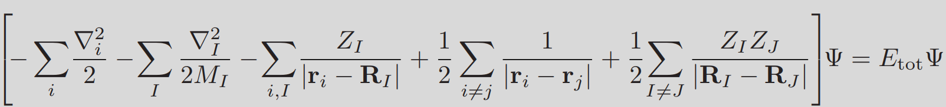
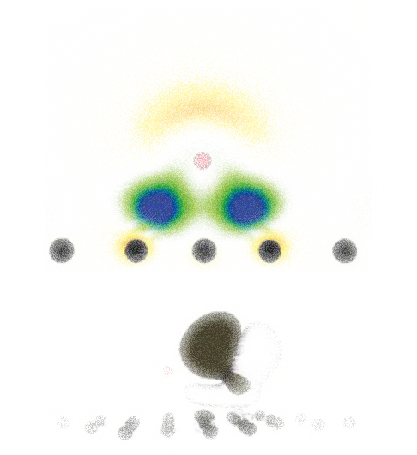
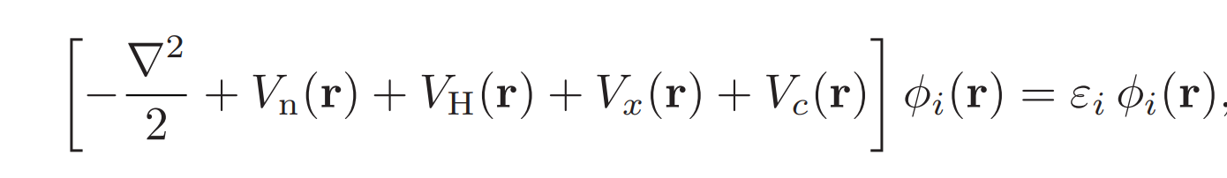
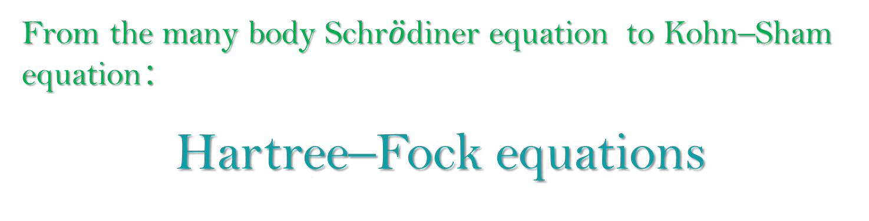
Density Functional Theory
From the many body Schr$\ddot{o}$diner equation to Kohn–Sham equation：
Hartree–Fock equations
Summary
Magnetic
Structure
Electronic
Junfei Ding 10-Sep-2020

Slide 2
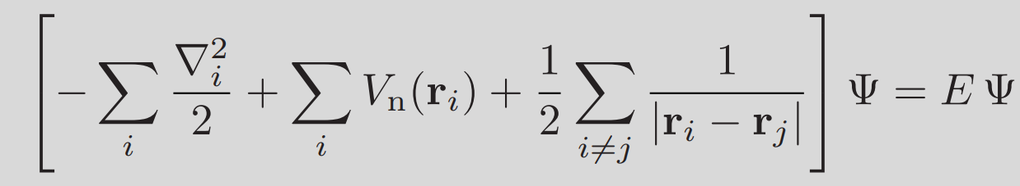
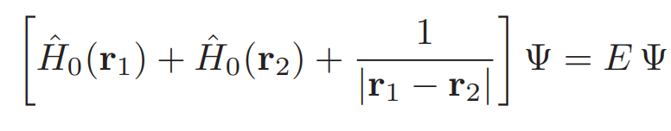
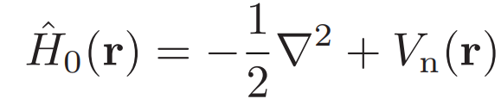
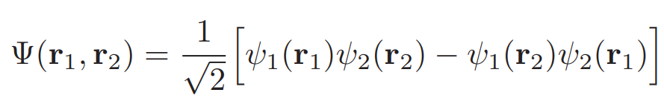
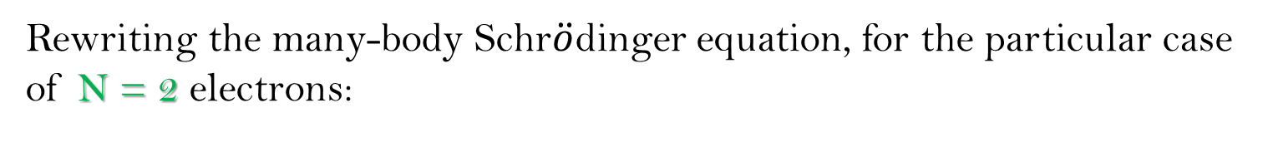
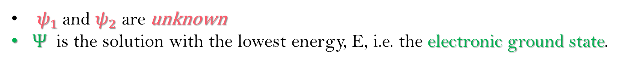
Hartree–Fock equations
Rewriting the many-body Schr$\ddot{o}$dinger equation, for the particular case of N = 2 electrons:
Summary
Magnetic
Structure
Electronic
$ψ_{1}$and $ψ_{2}$ are unknown
Ψ is the solution with the lowest energy, E, i.e. the electronic ground state.

Slide 3

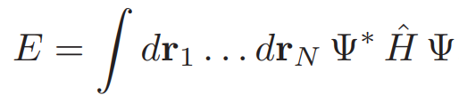
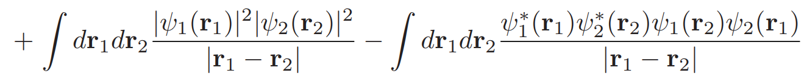
Hartree–Fock equations
In order to find the functions $ψ_{1}$and $ψ_{2}$which minimize the total energy, the first step is to write E as an explicit functional of the wavefunctions.
$$E\left(r_{1},r_{2}\right)={\left\{\frac{1}{\sqrt{2}}\left[ψ_{1}\left(r_{1}\right)ψ_{2}\left(r_{2}\right)−ψ_{1}\left(r_{2}\right)ψ_{2}\left(r_{1}\right)\right]\right\}}^{∗}\left[{\hat{H}}_{0}\left(r_{1}\right)+{\hat{H}}_{0}\left(r_{2}\right)+\frac{1}{\left|r_{1}−r_{2}\right|}\right]\left\{\frac{1}{\sqrt{2}}\left[ψ_{1}\left(r_{1}\right)ψ_{2}\left(r_{2}\right)−ψ_{1}\left(r_{2}\right)ψ_{2}\left(r_{1}\right)\right]\right\}$$
Summary
Magnetic
Structure
Electronic

Slide 4
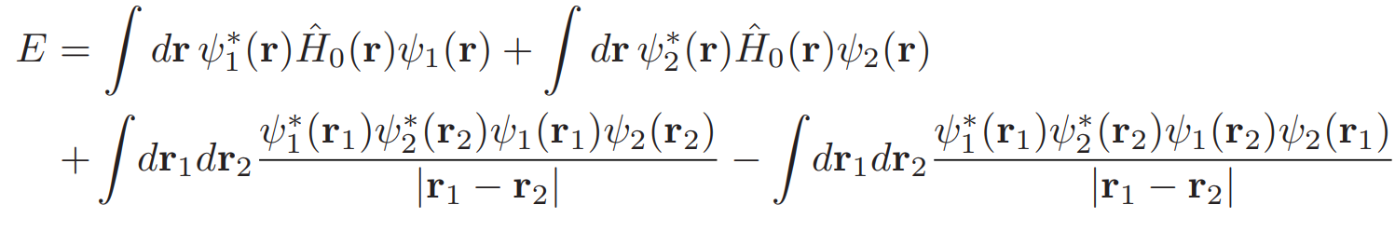
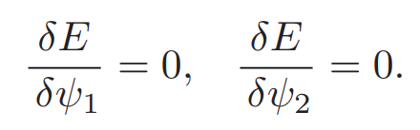
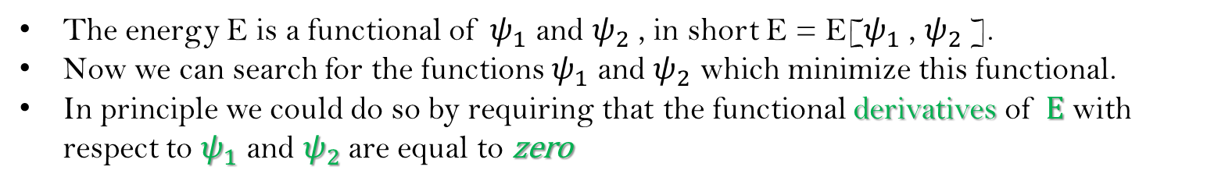
Hartree–Fock equations
Summary
Magnetic
Structure
Electronic
The energy E is a functional of $ψ_{1}$ and $ψ_{2}$ , in short E = E[$ψ_{1}$ , $ψ_{2}$ ].
Now we can search for the functions $ψ_{1}$ and $ψ_{2}$ which minimize this functional.
In principle we could do so by requiring that the functional derivatives of E with respect to $ψ_{1}$ and $ψ_{2}$ are equal to zero

Slide 5
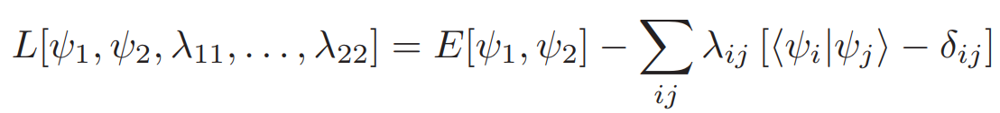
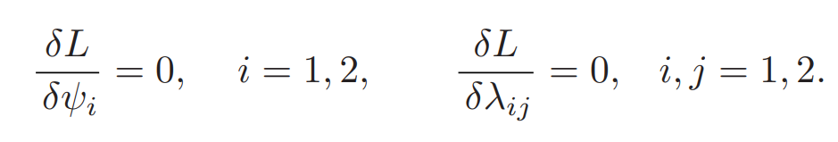
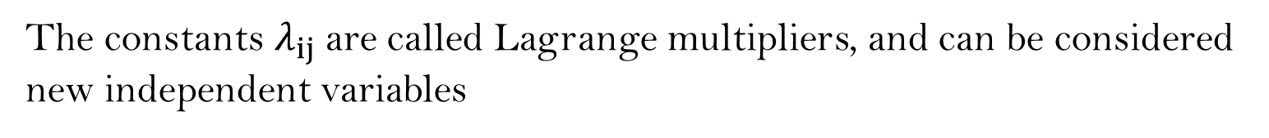
Hartree–Fock equations
Lagrange multipliers
Summary
The constants $λ_{ij}$are called Lagrange multipliers, and can be considered new independent variables
Magnetic
Structure
Electronic

Slide 6
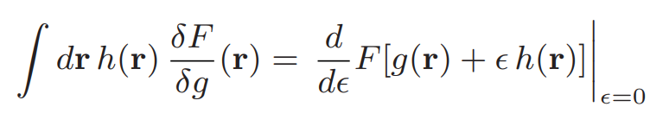
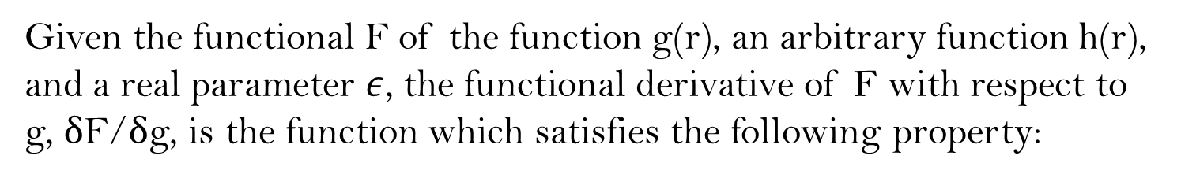
Hartree–Fock equations
Given the functional F of the function g(r), an arbitrary function h(r), and a real parameter $ε$, the functional derivative of F with respect to g, δF/δg, is the function which satisfies the following property:
Summary
Magnetic
Structure
Electronic

Slide 7
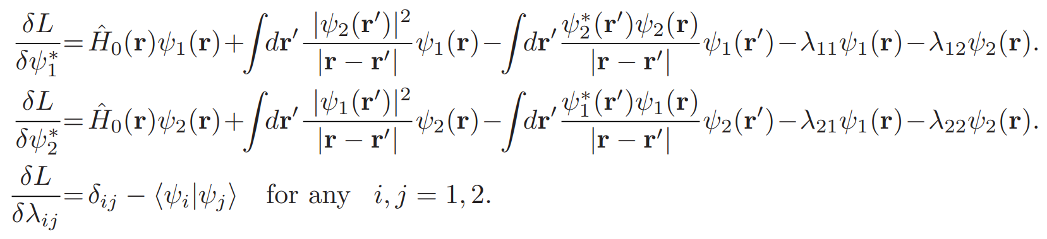
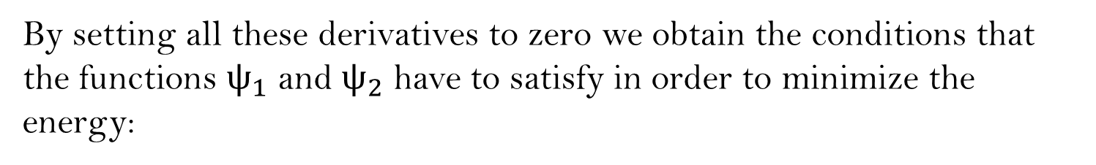
Hartree–Fock equations
Summary
Magnetic
Structure
Electronic
By setting all these derivatives to zero we obtain the conditions that the functions ${\text{ψ}}_{1}$ and ${\text{ψ}}_{2}$ have to satisfy in order to minimize the energy:

Slide 8
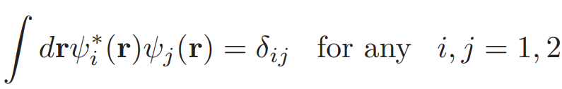
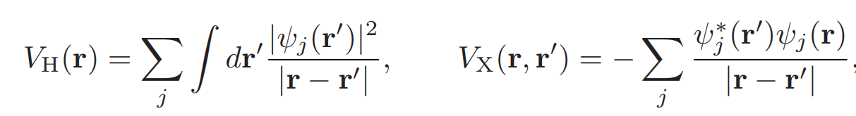
Hartree–Fock equations
Summary
Magnetic
Structure
Electronic
Use the expression for the Hartree potential and the exchange potential:

Slide 9
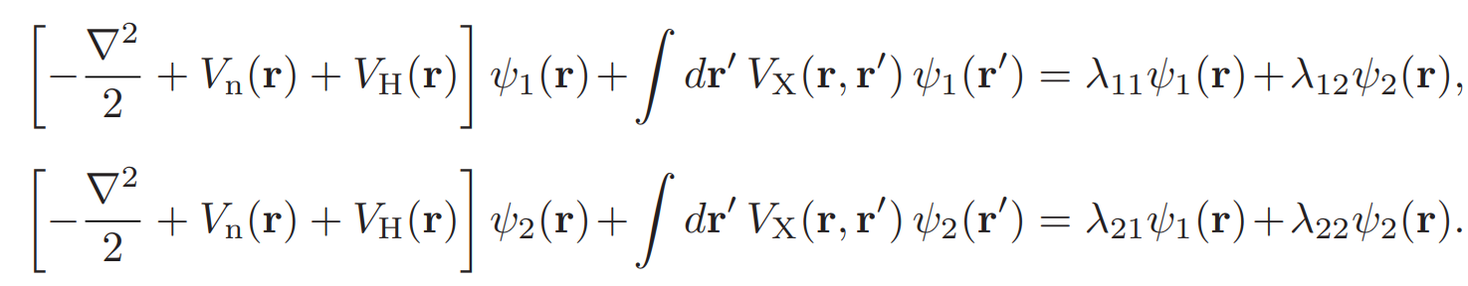
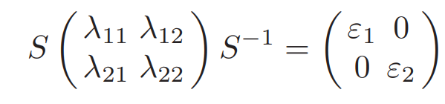
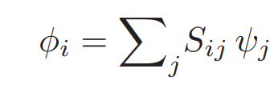
Hartree–Fock equations
Summary
Magnetic
Structure
Electronic
introducing a 2×2 matrix, S, which diagonalizes the Lagrange multipliers

Slide 10
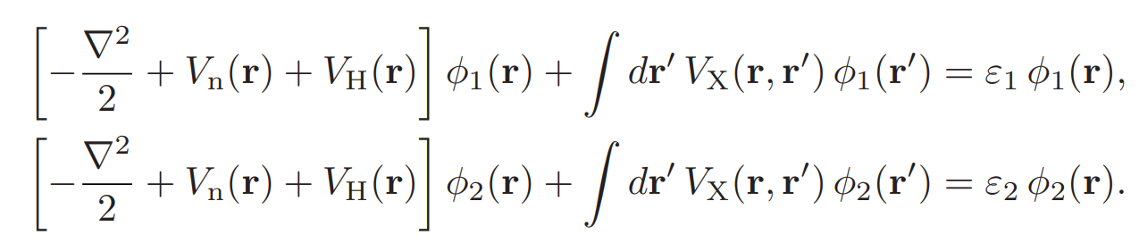
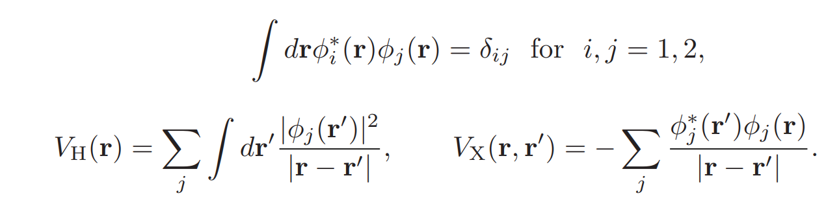
Hartree–Fock equations
Summary
Magnetic
Structure
Electronic
These equations are precisely the Hartree–Fock equations

Slide 11

Hartree–Fock equations
In the case of N electrons the derivation is identical to the above, the only differences being that we obtain N equations like equation
$\left[−\frac{∇^{2}}{2}+V_{n}(r)+V_{H}(r)\right]φ_{1}(r)+∫dr^{′}V_{X}\left(r,r^{′}\right)φ_{1}\left(r^{′}\right)=ε_{1}φ_{1}(r)$,
and the sums in
$V_{H}(r)=\sum_{j}{ }∫dr^{′}\frac{{\left|φ_{j}\left(r^{′}\right)\right|}^{2}}{\left|r−r^{′}\right|}(∇^{2}V_{H}\left(r\right)=−4πn\left(r\right)),V_{X}\left(r,r^{′}\right)=−\sum_{j}{ }\frac{φ_{j}^{∗}\left(r^{′}\right)φ_{j}(r)}{\left|r−r^{′}\right|}$
run over the N wavefunctions $φ_{i}$ with the lowest-energy eigenvalues, $ε_{i}$.
Summary
Magnetic
Structure
Electronic

Slide 12

Hartree–Fock equations
$$\left[−\frac{∇^{2}}{2}+V_{n}\left(r\right)+V_{H}\left(r\right)\right]φ_{i}(r)+∫dr^{′}V_{X}\left(r,r^{′}\right)φ_{i}\left(r^{′}\right)=ε_{i}φ_{i}(r)$$
$$n(r)=\sum_{i}{ }{\left|φ_{i}\left(r\right)\right|}^{2}$$
$$∇^{2}V_{H}\left(r\right)=−4πn\left(r\right)$$
$$V_{X}\left(r,r^{′}\right)=−\sum_{j}{ }\frac{φ_{j}^{∗}\left(r^{′}\right)φ_{j}\left(r\right)}{\left|r−r^{′}\right|}$$
(For $V_{X}$ the sum runs over the occupied single-particle states, and is non-local in the sense that its evaluation involves an integration over the additional variable ${\text{r}}^{′}$ )
Summary
Magnetic
Structure
Electronic

Slide 13
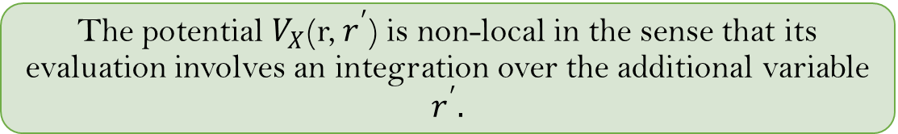

Hartree–Fock equations
The good thing about the Hartree–Fock equations is that we moved from ‘classical’ electrons in the mean-field approximation to ‘quantum’ electrons.
The bad thing is that this refinement introduces the non-local potential $V_{X}$(r, $r^{′}$) in the single-particle equations.
Summary
Magnetic
Structure
Electronic
The potential $V_{X}$(r, $r^{′}$) is non-local in the sense that its evaluation involves an integration over the additional variable $r^{′}.$
This complicates enormously the practical solution of the Hartree–Fock equations.

